Slide 1
JAVA Lecture 14
Exceptions in Java

Slide 2
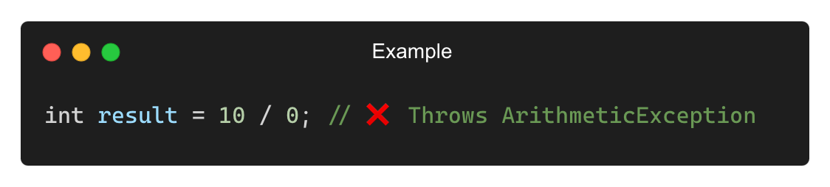
What is an Exception?
An unexpected event that occurs during program execution.
It disrupts the normal flow of the program.
Why Do Exceptions Occur?
❌ Invalid user input (e.g., dividing by zero)
❌ File not found (e.g., accessing a missing file)
❌ Network issues (e.g., connection failures)
❌ Null references (e.g., accessing methods on null objects)
Example (Dividing by Zero):

Slide 3
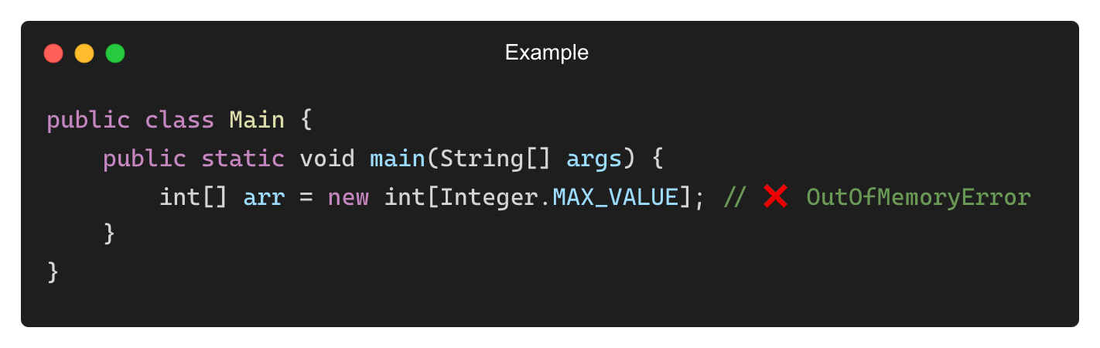
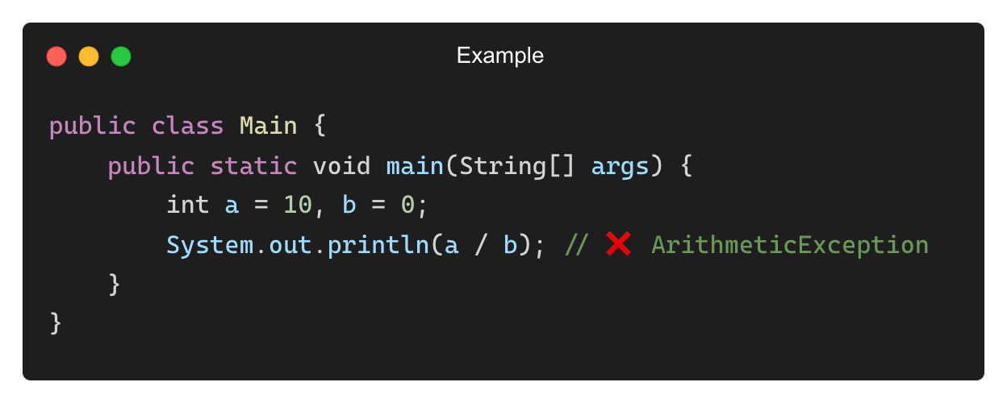
Difference Between Errors and Exceptions
Feature | Error | Exception
Type | Critical system issue | Recoverable issue
Occurrence | JVM-related (OutOfMemoryError) | Application-related (IOException)
Handling | Cannot be caught | Can be caught using try-catch
Example of Error (Not Recoverable):
Example of Exception (Recoverable):

Slide 4
Java’s Exception Handling Mechanism
Java handles exceptions using five keywords:
Keyword | Description
try | Defines a block where exceptions may occur
catch | Handles the exception thrown in try.
finally | Executes after try-catch, whether an exception occurs or not.
throw | Used to explicitly throw an exception.
throws | Declares exceptions that a method might throw.

Slide 5
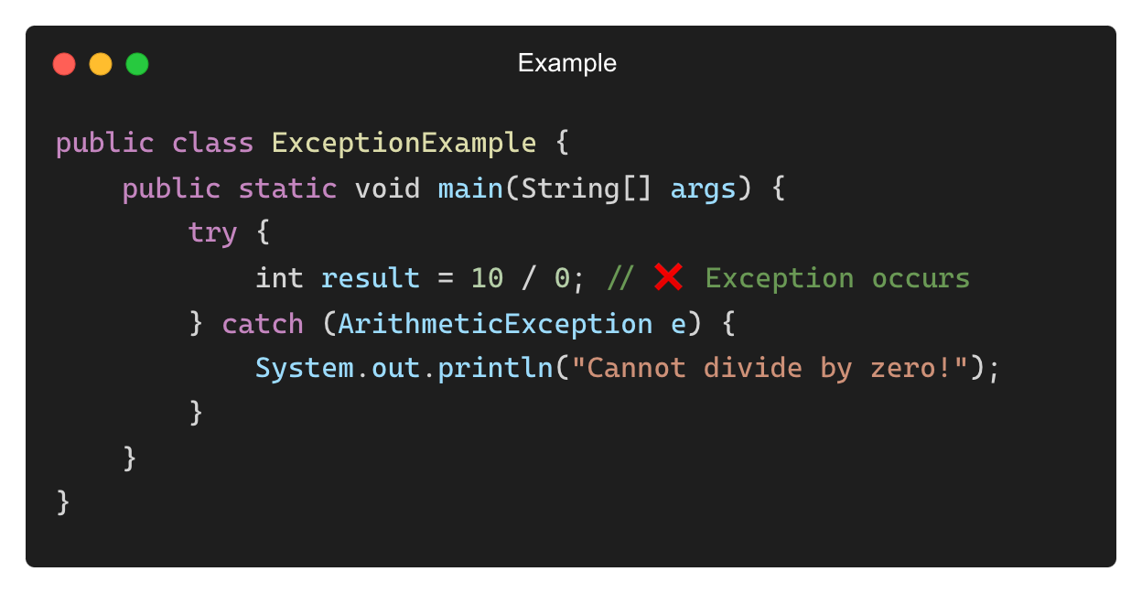
Using try and catch Blocks
Example: Handling an ArithmeticException
Output:
Cannot divide by zero!

Slide 6
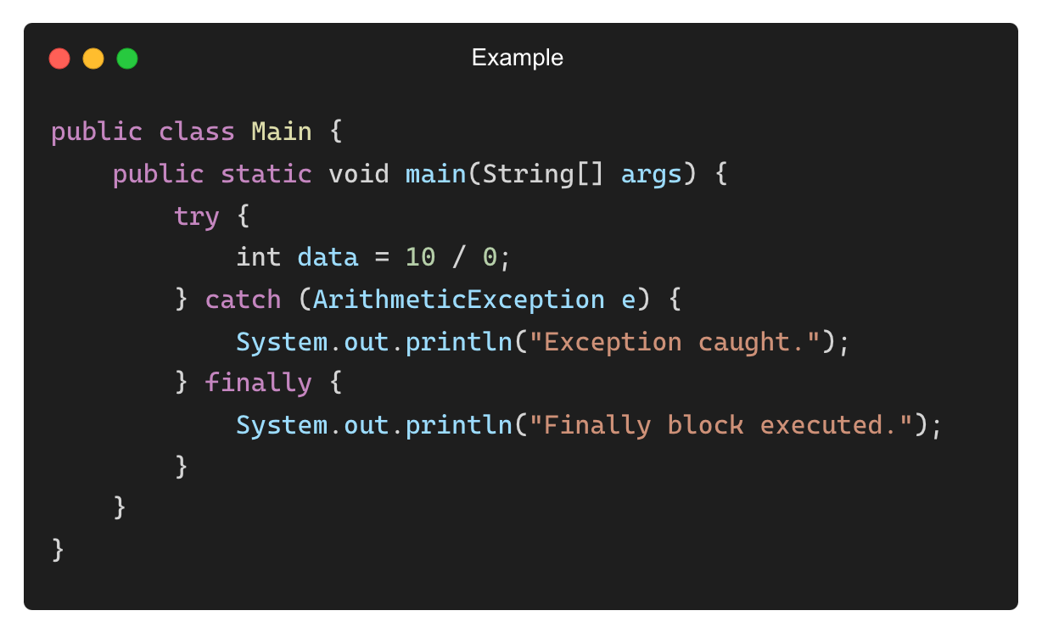
Using finally Block
The finally block always executes, even if an exception occurs.
Output:
Exception caught.
Finally block executed.

Slide 7
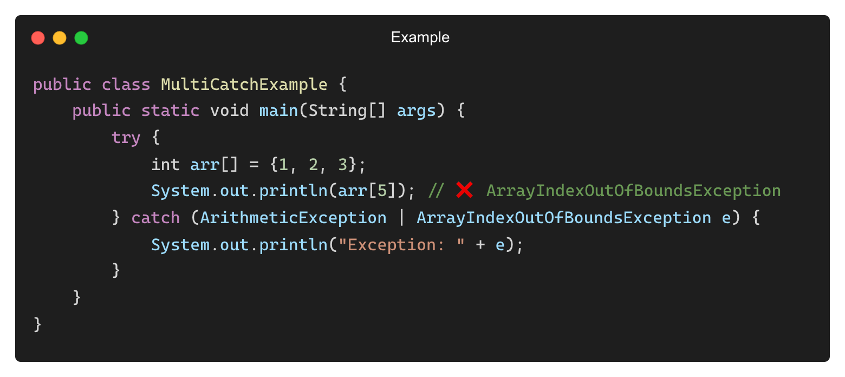
Handling Multiple Exceptions in One catch Block (Java 7+)
Example: Handling multiple exceptions using a single catch block
Output:
Exception: java.lang.ArrayIndexOutOfBoundsException

Slide 8
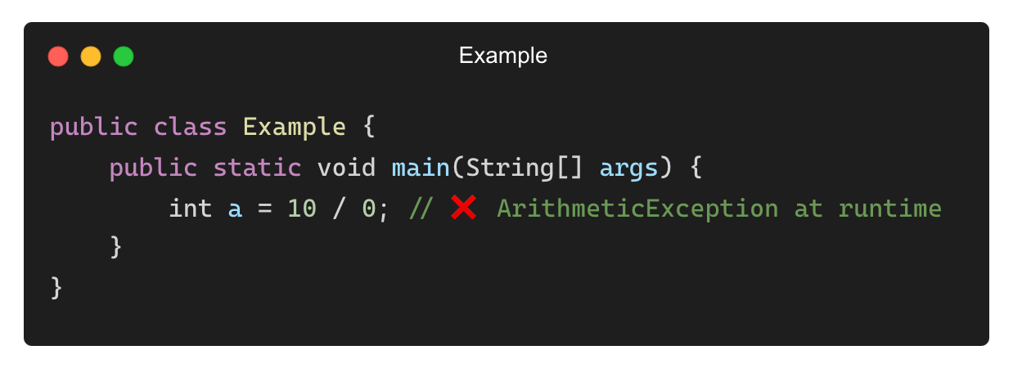
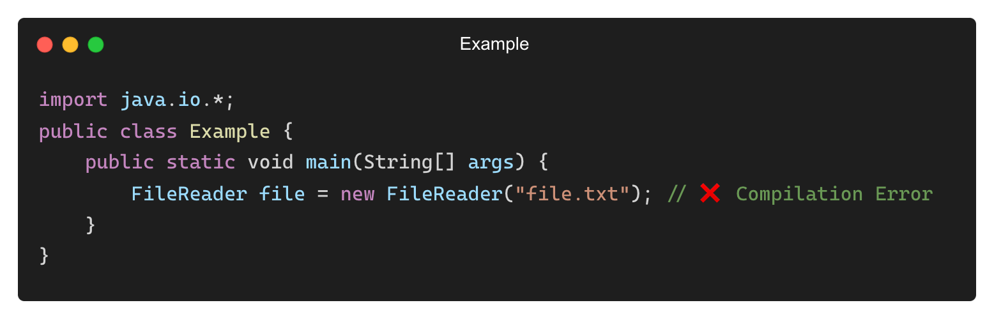
Types of Exceptions in Java
Java exceptions are categorized into two types:
Type | Description | Examples
Checked Exceptions | Must be handled using try-catch or throws | IOException, SQLException
Unchecked Exceptions | Occur at runtime and do not require explicit handling. | NullPointerException, ArithmeticException
Checked Exceptions (Compile-time Errors):
Java forces handling these exceptions.
• Unchecked Exceptions (Runtime Errors):

Slide 9
Common Java Exception Types
Exception | Type | Cause
ArithmeticException | Unchecked | Division by zero
NullPointerException | Unchecked | Accessing a null object
ArrayIndexOutOfBoundsException | Unchecked | Accessing an invalid array index
FileNotFoundException | Checked | File does not exist
IOException | Checked | Issues during input/output operations
SQLException | Checked | Errors in database operations

Slide 10
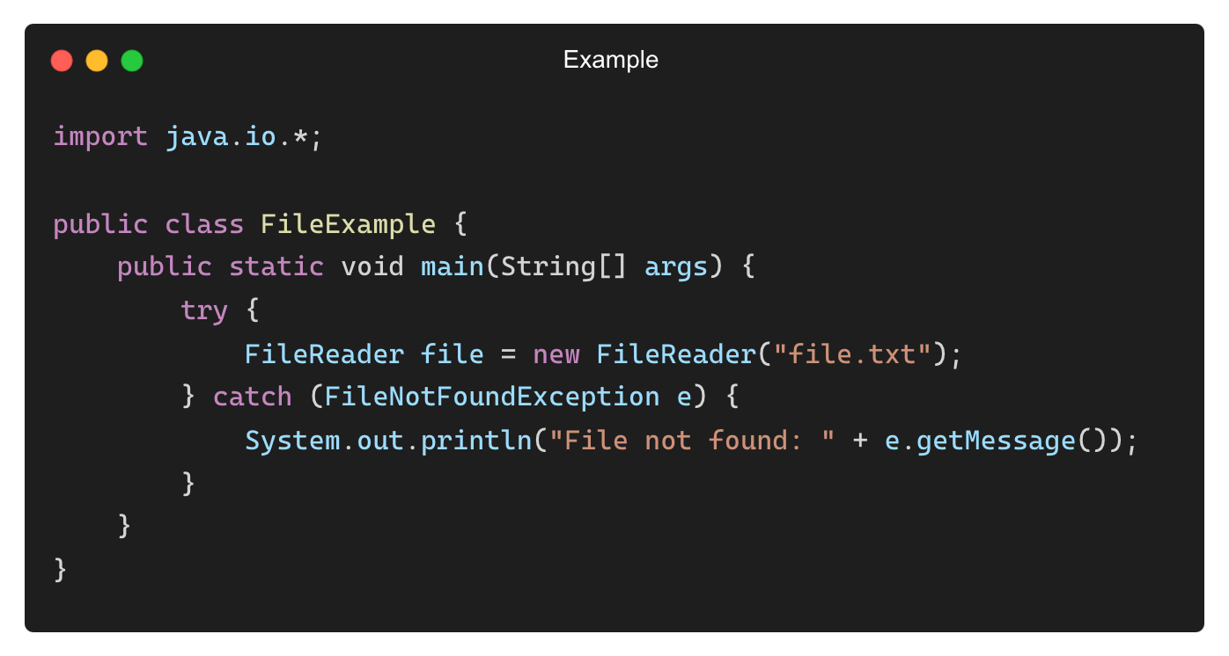
Handling Checked Exceptions with try-catch
• Example: Handling IOException
Output:
File not found: file.txt (No such file or directory)

Slide 11
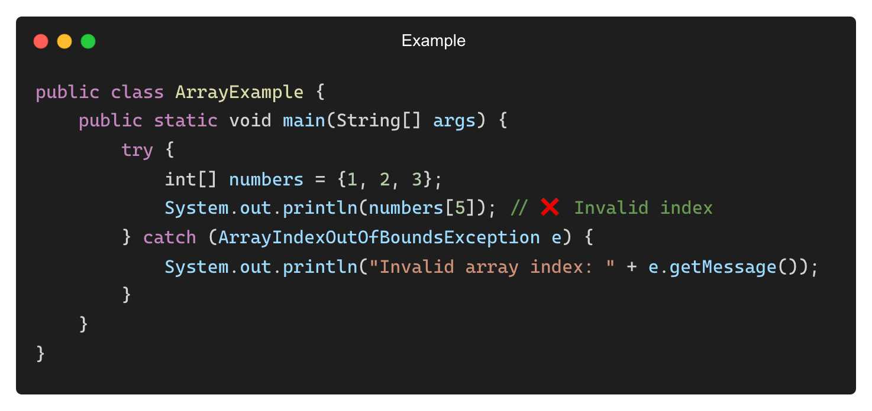
Handling Unchecked Exceptions with try-catch
• Example: Handling ArrayIndexOutOfBoundsException
Output:
Invalid array index: 5

Slide 12
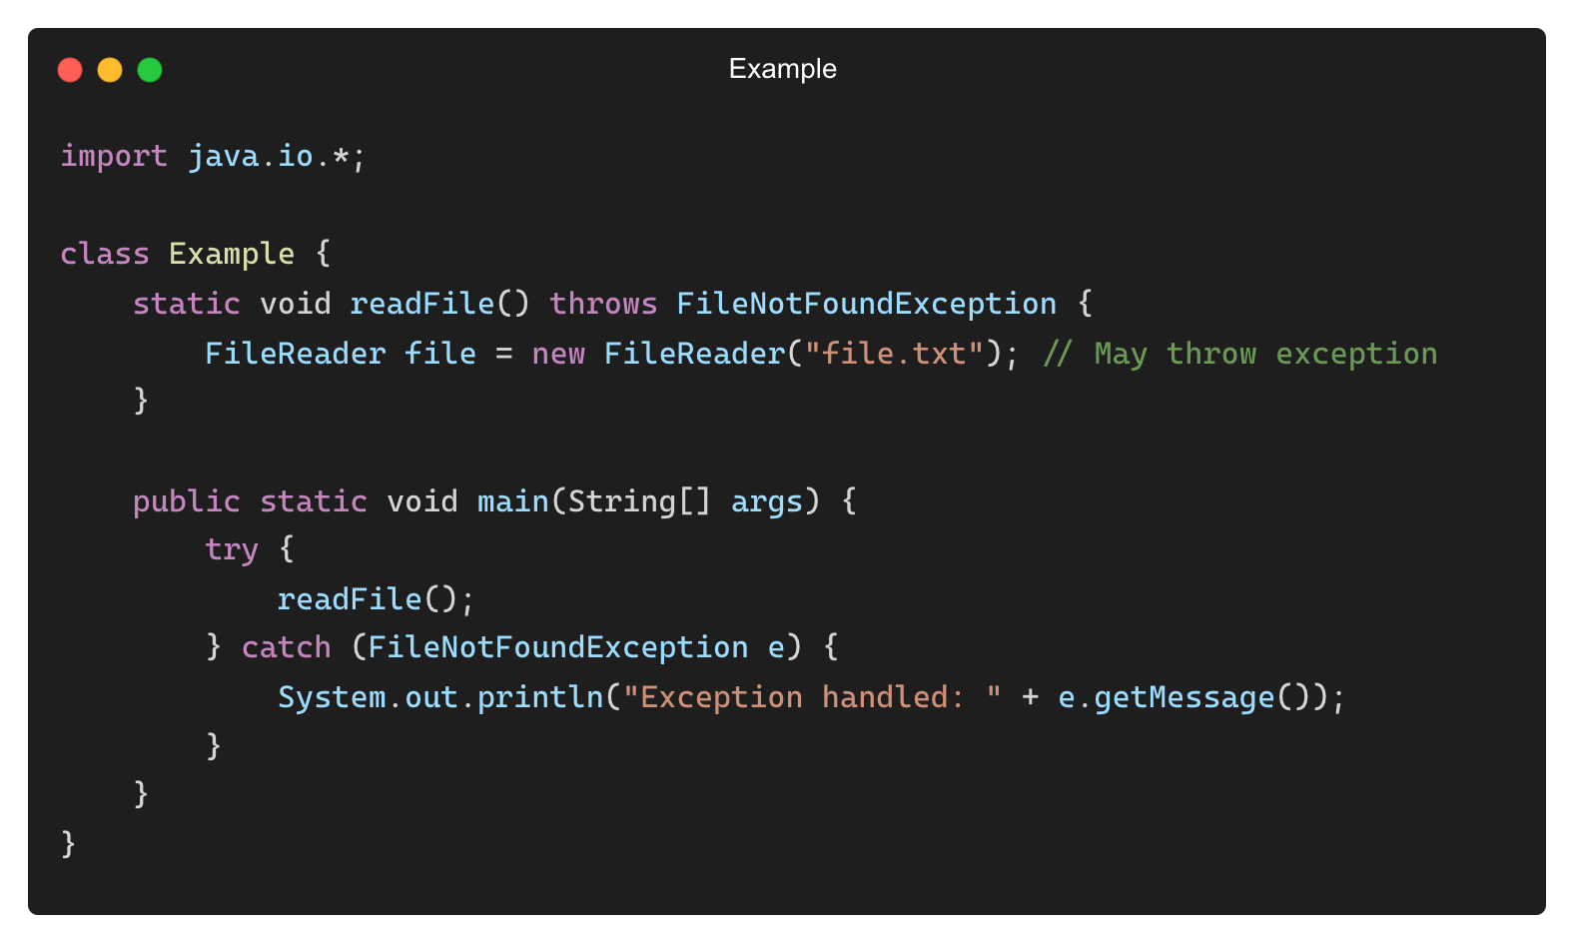
Using throws to Propagate Exceptions
• The throws keyword allows a method to delegate exception handling to the caller.
• Example: Declaring an Exception in a Method Signature
Output:
Exception handled: file.txt (No such file or directory)

Slide 13
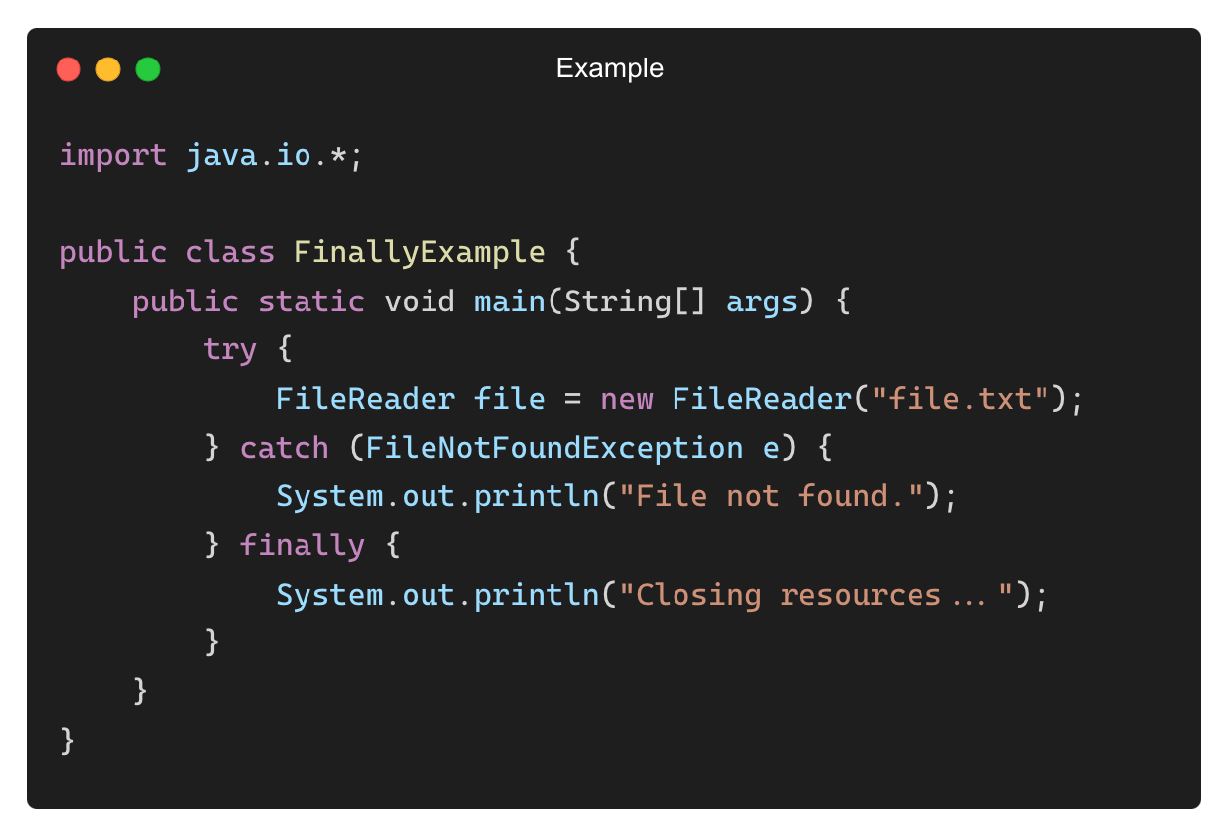
Using finally to Ensure Cleanup
• The finally block always executes, even if an exception occurs.
• Example:
Output:
File not found.
Closing resources...

Slide 14
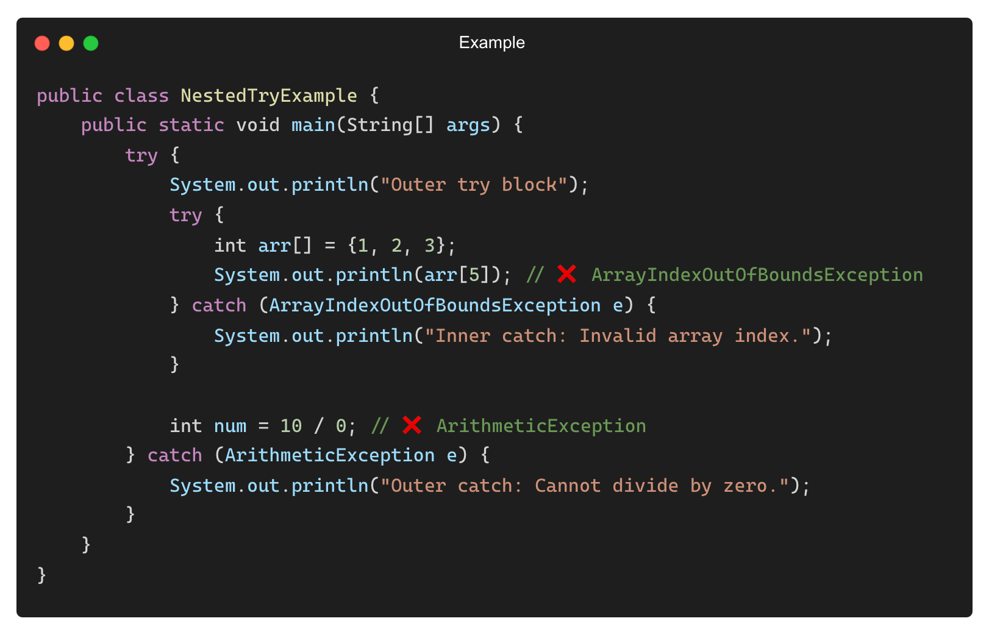
Nested try Blocks in Java
A try block inside another try block is called a nested try block.
Why Use Nested try Blocks?
✅ Handle specific exceptions inside specific sections of the code.
✅ Ensures finer control over error handling.
Output:
Outer try block
Inner catch: Invalid array index.
Outer catch: Cannot divide by zero.

Slide 15
THANK YOU

